Slide 2
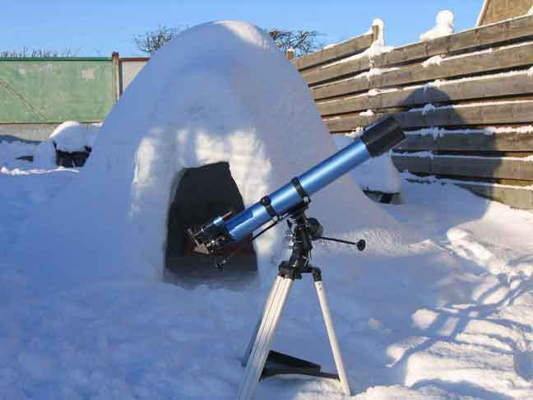
Building a backyard observatory
Gord Tulloch,
RASC, Winnipeg Centre AAVSO:TGR
Notes:
AAVSO TGR – rawr. That will be the only cat reference in this presentation.

Slide 3
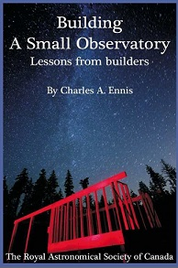
Rasc publication
This book is the result of interviews with 140 small observatory owners in 10 countries to discover what it takes to fund, build, and operate a small observatory. As a planning guide, it will help you maximize your chances of successfully creating a trouble-free installation, and help find the best site and equipment. Learn from the experience of those who went before you. Don't make the mistakes that others have made!
Your price: $17.95

Slide 4
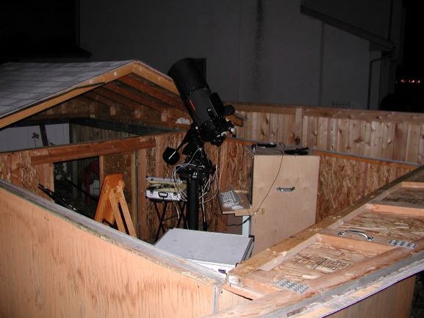
WHY an observatory?
5 minutes to open/close means you will observe more
Setup and teardown hard on equipment
Permanent power/network setup
GOTO Alignments and Polar Alignment simplified
Place to store equipment and accessories

Slide 5
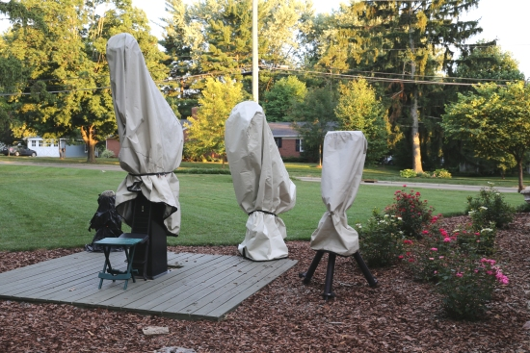
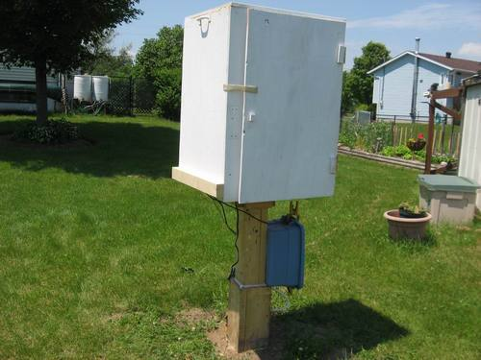
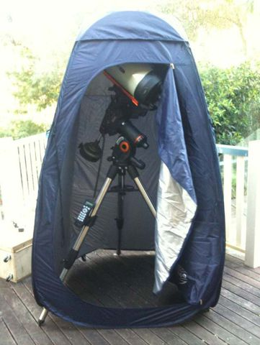
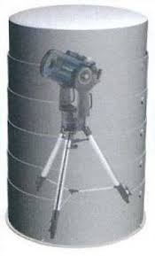
Cover
Simple cover to protect the telescope when not in use
Super-fast setup
Not weather proof
No wind protection
No critter protection
Note Walmart biffy tent use ☺

Slide 6
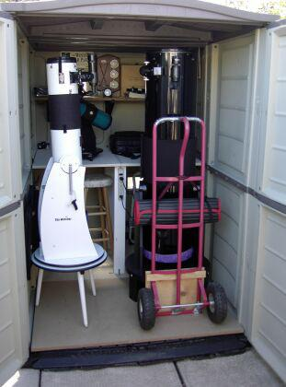
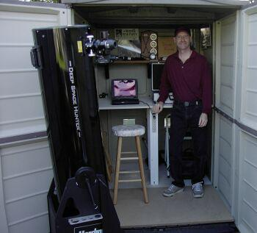
Fixed shed
There’s a lot to be said for storing astrogear in a shed so it can be pulled out at a moments notice
Simple and cheap plastic sheds
Pros: Quick setup, shed can provide wind shelter and house computer and other equipment
Cons: Still have to wheel out and assemble equipment, harder to critter proof and weather proof

Slide 7
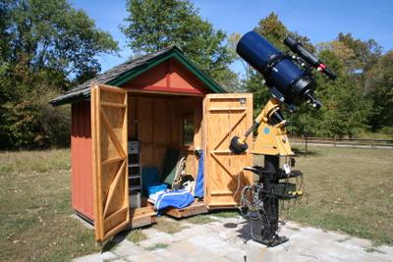
ROLL OFF SHED
Rather than the roof rolling off, the whole structure does
Pros: Whole sky access, light and easy to roll off, shed provides cover for observer
Cons: No wind protection, ground rails can get fouled, snow can be a big issue

Slide 8
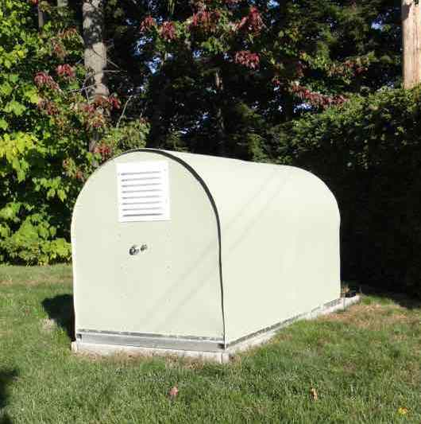
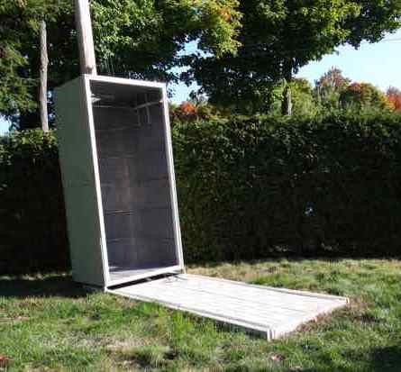
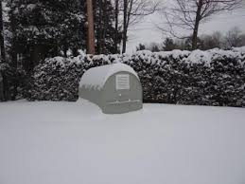
Fold off variant
In this variant the shed lifts off and hinges back
No issues with snow/ice in tracks
Easily secured and critter-proofed
Pierre Lamay Montreal

Slide 9
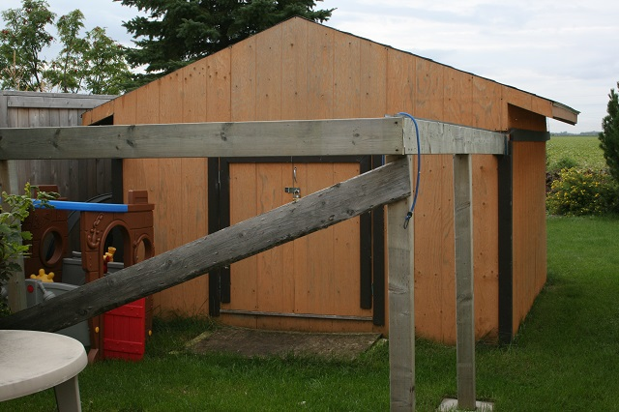
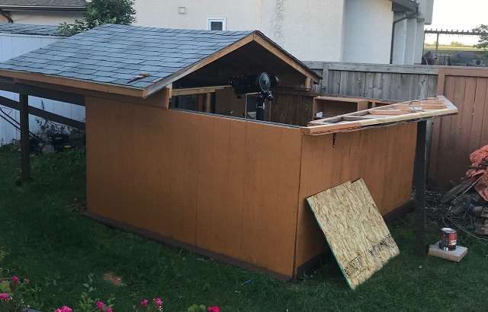
Roll-off / run-off roofs
Shed with some portion of the roof that slides back to expose a telescope
Pro: full sky exposure, cheap to build, not complex, lots of room
Con: no wind protection, larger footprint (obs size x 2),more maintenance reqd, critter proofing harder
Worst case it’s a garden shed for your lawn mower

Slide 10
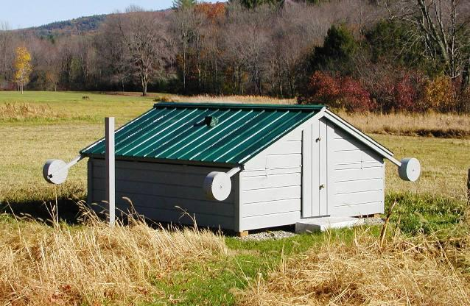
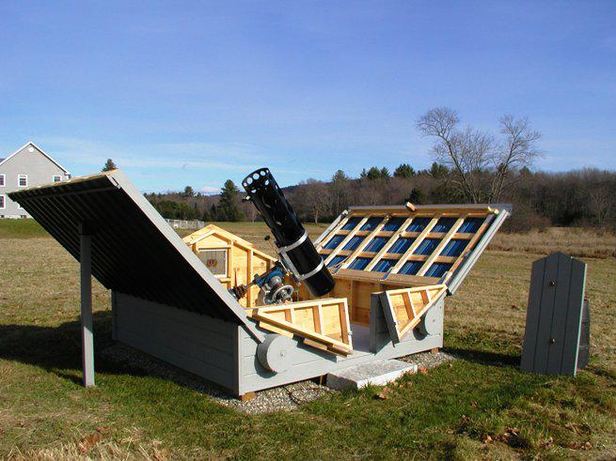
FOLDING ROOF
Similar to ROR but roof doesn’t slide off but opens
Lots of possible variations
Counterweighting important
Pros and cons the same as ROR
Peter T. (New England)

Slide 11
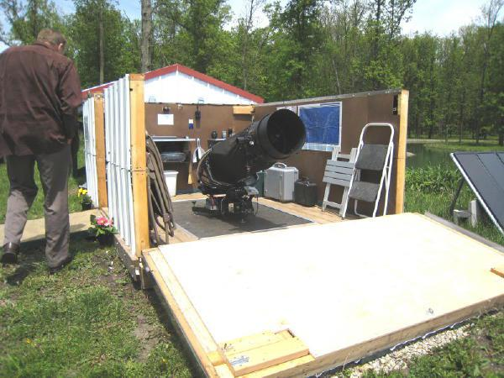
Folding walls
Dobs and split ring scopes introduce special issues!
In this observatory the front wall folds down completely and the side walls 50%
Can be used for various configurations
Notes:
I always thought a geodescic dome would be a better idea for a dob

Slide 12
domes
Traditional rotating dome with a slit for telescope to view out of
Pros: Cover from wind, less stray light, smaller footprint
Cons: Expensive to buy, hard to build, no full sky access, cramped

Slide 13
Rotating roofs
Easier to build than domes
Same pros and cons

Slide 14
Built-in domes/rors
Observatory built into roof of building
Very convenient
Hard to make a pier
Access tends to use up a lot of space on the floor below
Heat rising from the building is an issue
Vibration from other occupants can be an issue
Jrcrilly (Akron OH)

Slide 15
Building spao

Slide 16
Building SPAO
Been an ambition since I was a kid
Designed to house 16” Horseshoe mounted telescope (that never ended up being finished)
Built in 2002 from Revy build it yourself shed kit
Cost about $1,200
Very good N NE E SE S SW exposure
Yes that tree is gone ☺

Slide 17
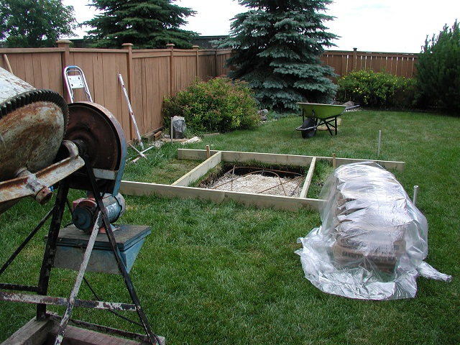
Building spao

Slide 18
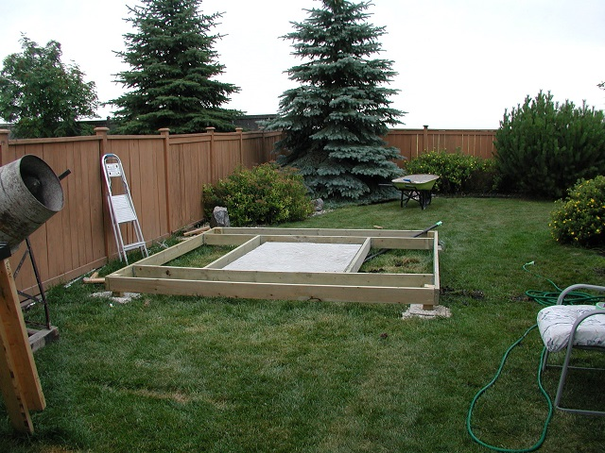
Building spao

Slide 19
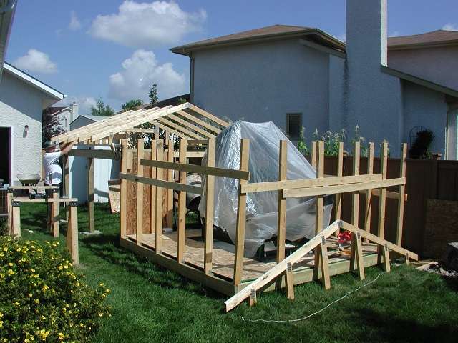
Building spao

Slide 20
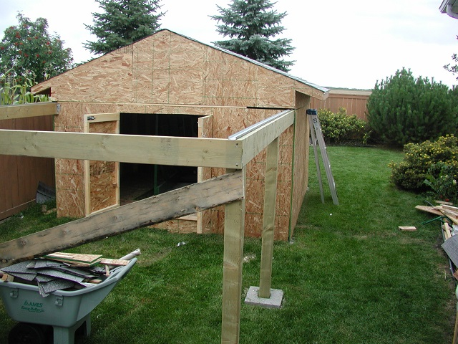
Building spao

Slide 21
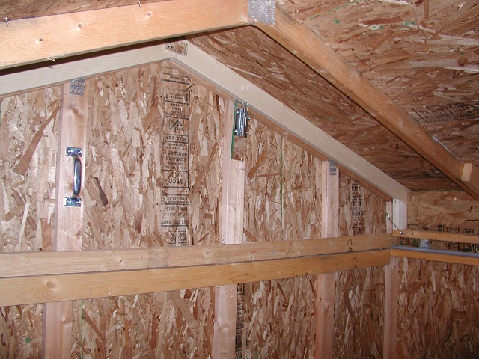
Building spao

Slide 22
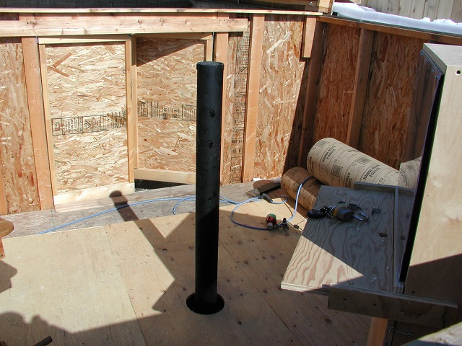
Building spao

Slide 23
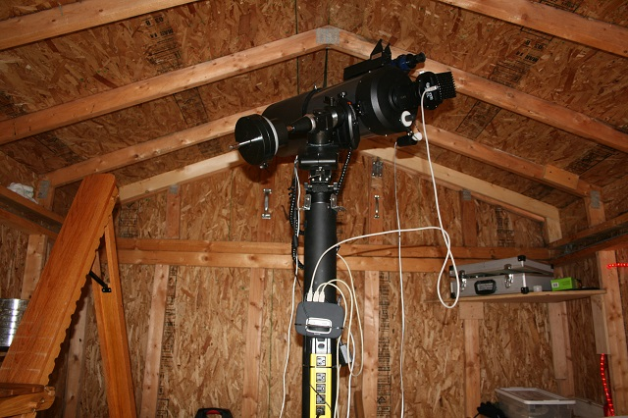
BUILDING SPAO

Slide 24
Decline and resurrection
In 2012 after very little use I decided to mothball the shed until the kids were older
Began resurrecting the shed in 2019
After evicting a lot of squirrels and a prodigious pine cone collection, needed:
New stain
Replacement of some wood that had been exposed and rotted
Relevel rails
New pier plate for new EQ-G mount
Used C8
Sad-oservatory

Slide 25
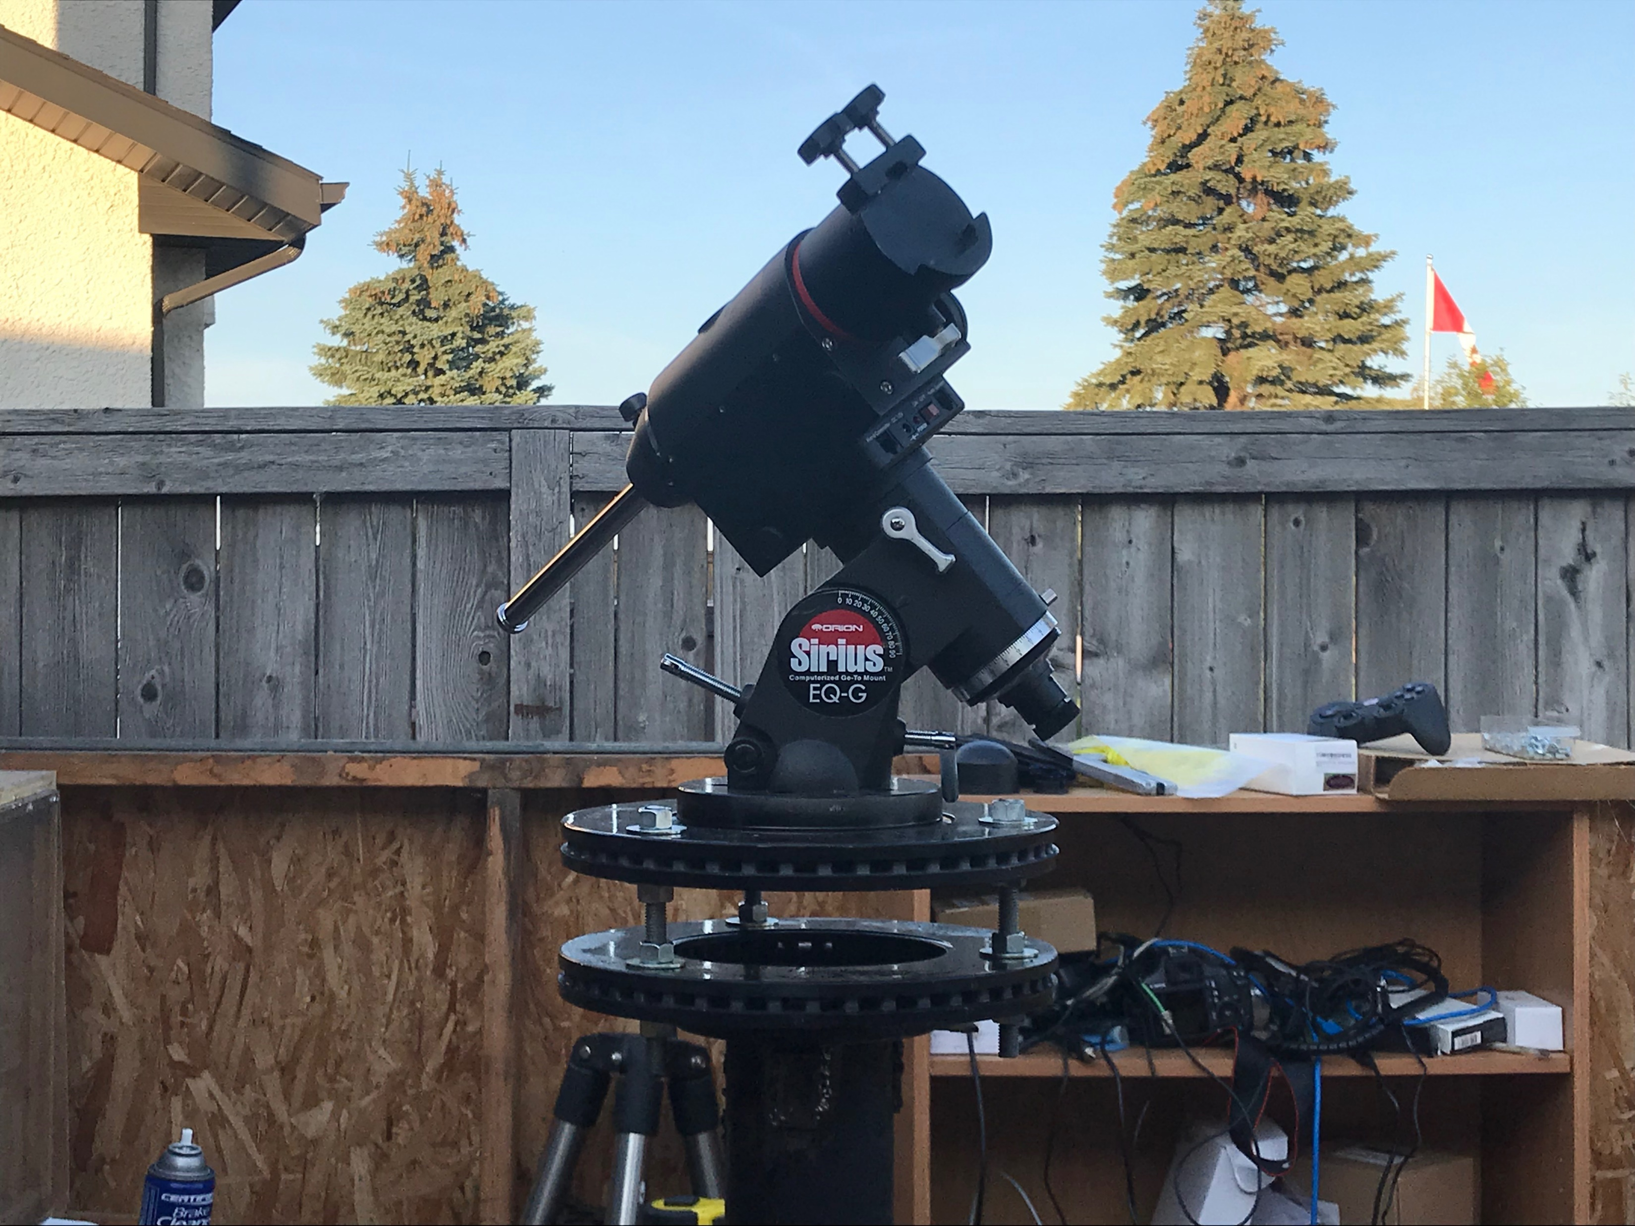
SPAO today
Exterior refreshed so attractive addition to our yard
Telescope mounted on new mount with very robust pier plate
Automation use Kstars/Ekos/RPI based INDI system’
Wireless network from the house (needed extender)
Operations centre in the house

Slide 26
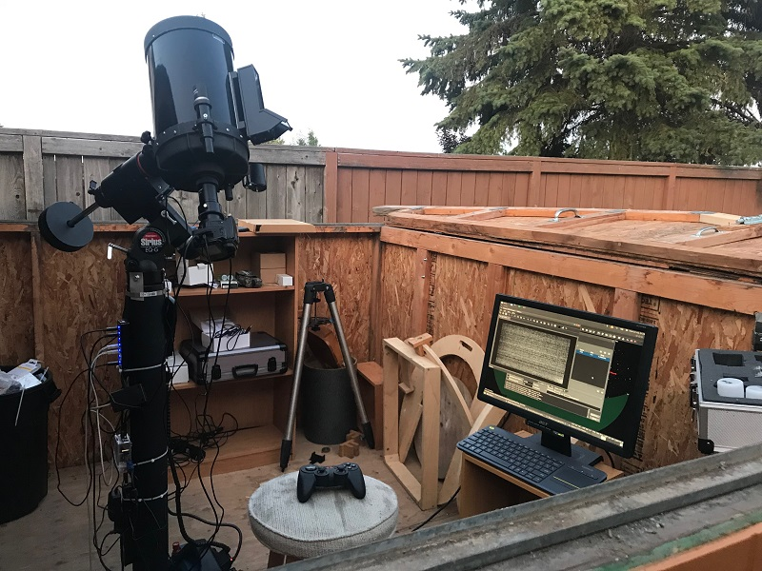
Workflow
Unlock
Power up the pier (and all equipment)
Drop gable
Roll off roof
Check everything up and running
Head into the house and run sequences in EKOS
Roll on roof
Lift gable
Lock up
C8
Accufocus
OAG/ SSG
Canon 1100D
Powered USB3 hub
Kstars/ EKOS
RPi 4B Stellarmate
Wireless Joypad
Local screen and keyboard to Pi during testing

Slide 27
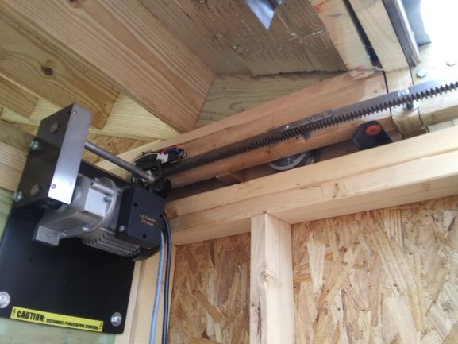
Future plans
More robust networking (1 Gb)
Flip off covers on rails
Replace heavy, hot roof with reflective steel to reduce heat and weight
Interior finishing
Add weather detectors (building a MeteoStation)
Automate roof roll-off – gate opener

Slide 28
Common mistakes
Make it big enough to comfortably move around
Isolate pier from pad!!
Consider winter operation
Be aware of present and future issues with location
Use materials that cool quickly – bricks/stone/asphalt poor choices
Expect cost over-runs
Make sure you double check zoning laws, code, and property lines and get permits – 108 sq ft not required
Ensure you have enough power to the observatory
Make security a primary design criteria
Critter proof from day 1
Plan for the future – that 5” SCT might be a 24” RCT one day!
Observa-fail – where do you stand?

Slide 29
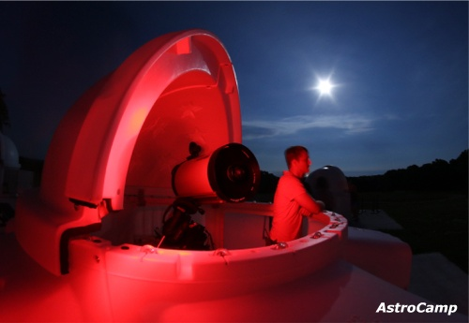
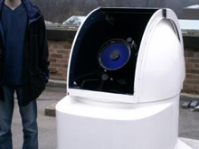
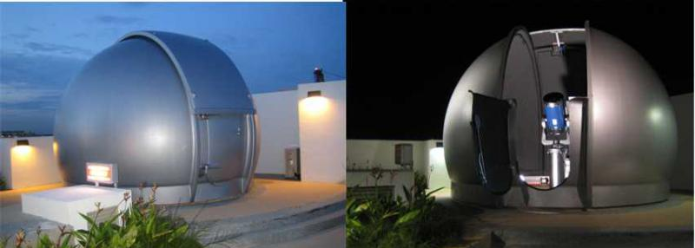
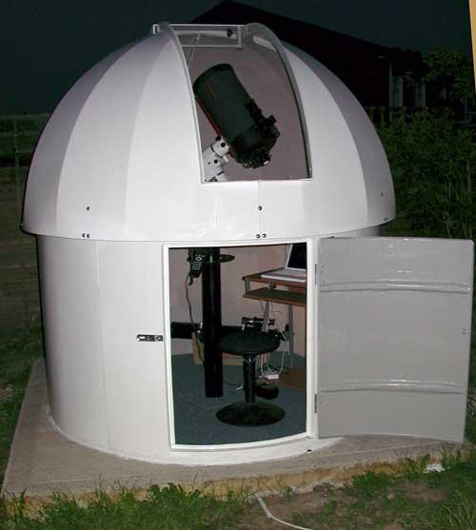
Commercial options
SkyShed - really nice ROR plans and finished kits, can even build for you as well as Pod observatories
Technical Innovations – Home Dome, Pro Dome, Robo-Dome
Backyard Observatories – custom RORs and automation systems
Astrohaven clamshell domes
Astrodome (AU)
Pulsar Observatories

Slide 30
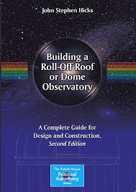
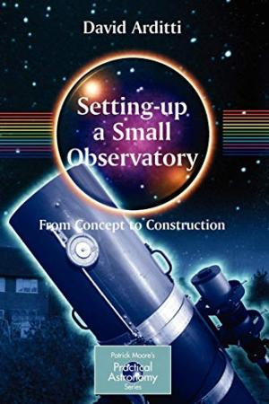
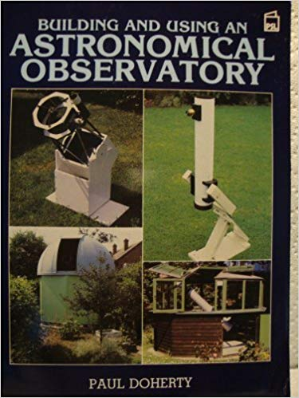
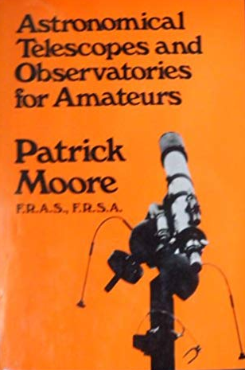
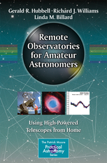
Good books

Slide 31
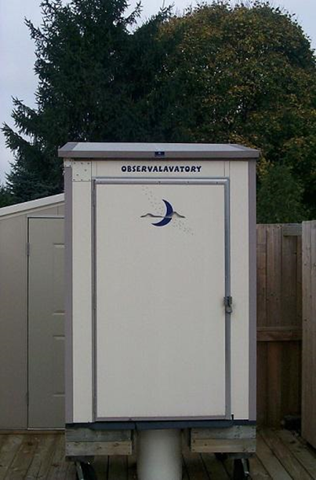
Questions?

