Slide 2
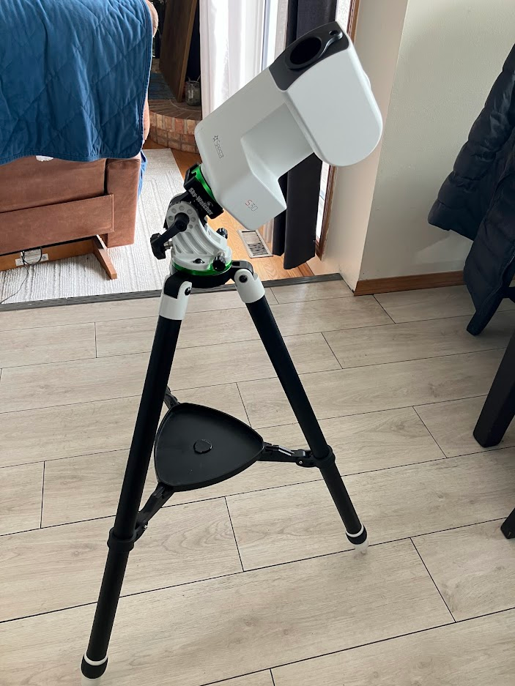
Howto: Using SEEstar 30/50 IN EQ MODE
Gord Tulloch, RASC, Winnipeg Centre

Slide 3
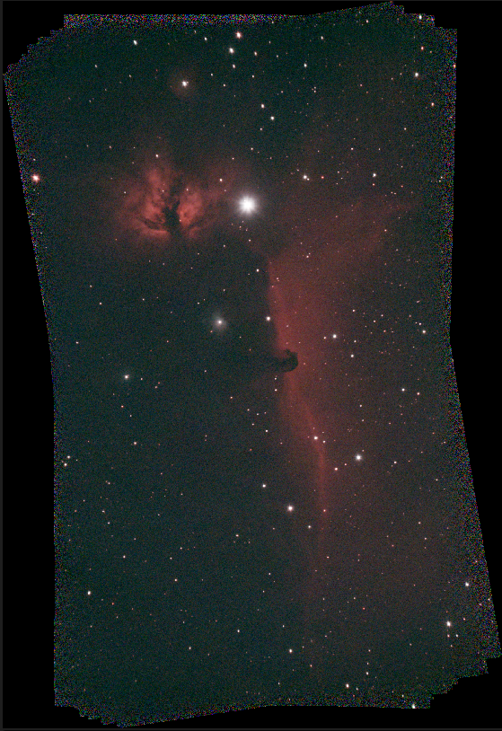
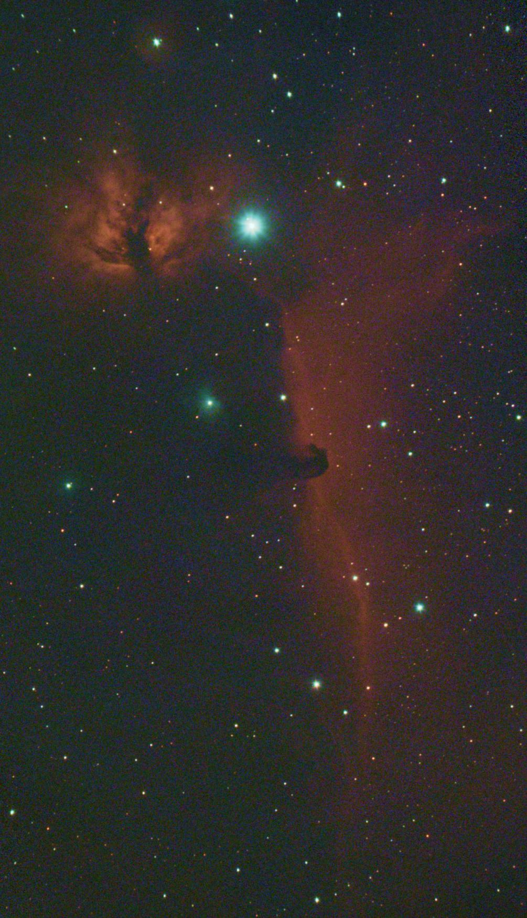
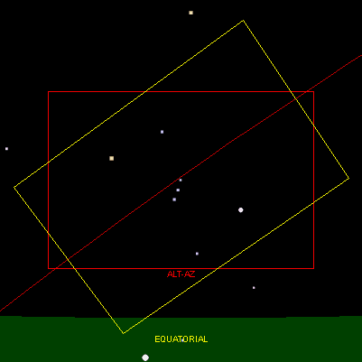
Why bother?
Field Rotation
As an object travels across the sky it rotates especially near the zenith
Altaz mountings see this as distortions and noise around the edges of the stack
Need to take mosaics when you don’t really need to so the object is clear of field rotation artifacts – much longer integrations needed
EQ Mode (Polar Alignment) eliminates field rotation
Less Dropped Frames
Longer Exposures? No - 10-20s max, no dithering leads to noise buildup
https://calgary.rasc.ca/field_rotation.htm By Larry McNish

Slide 4
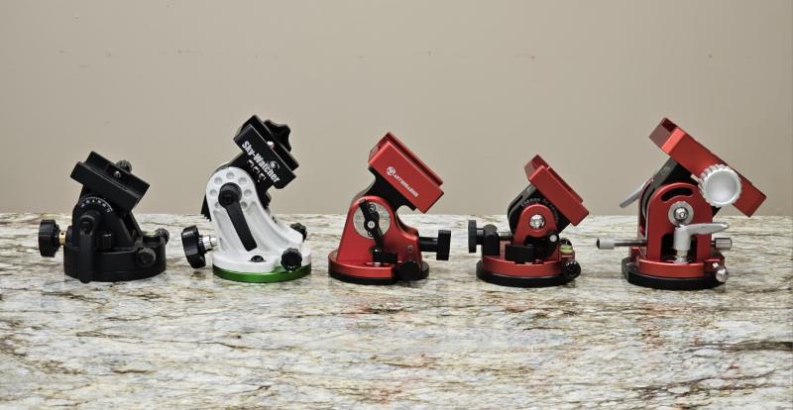
options
iOptron Alt-azimuth Adjustable Base #3327 ($100)
Sky-Watcher Star Adventurer Latitude (EQ) Base S20530 ($100-$120 if dovetail)
Aktuhrashid base ($175 from ebay)
iOptron Precision AZ/EQ Base #3328 ($315)
William Optics Vixen-style Latitude Base Mount ($325)
https://www.cloudynights.com/topic/958693-comparison-of-eq-wedge-base-options-for-smart-telescopes

Slide 5
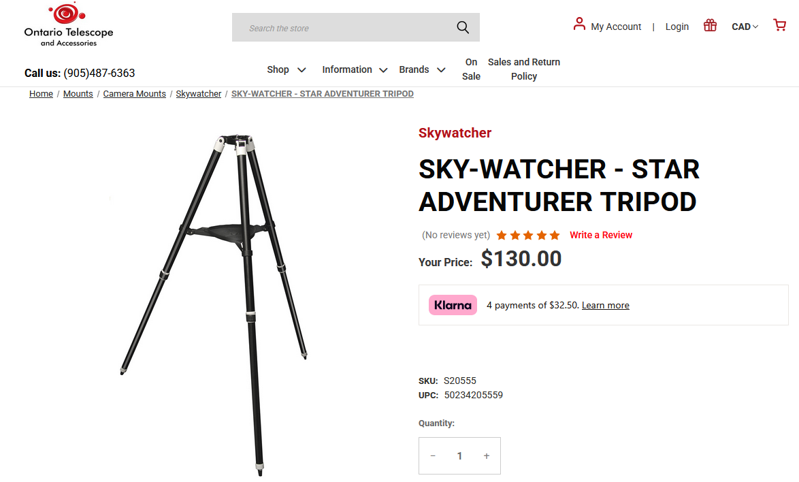
tripod

Slide 6
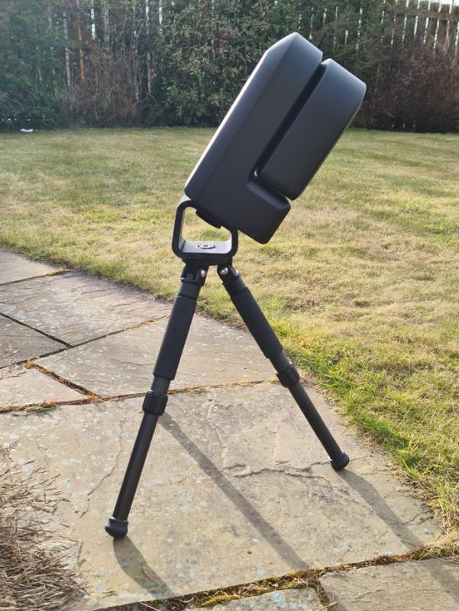
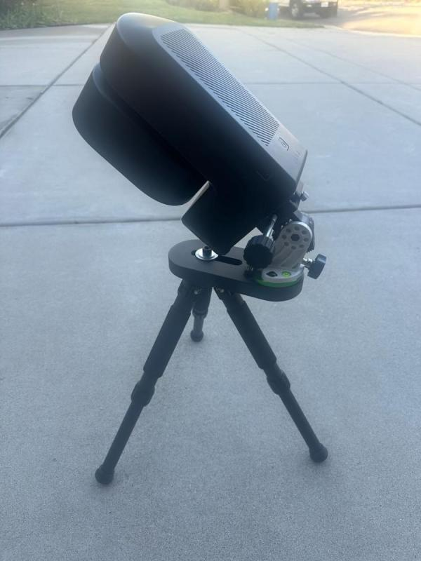
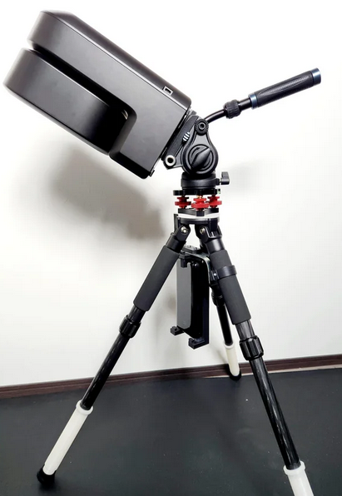
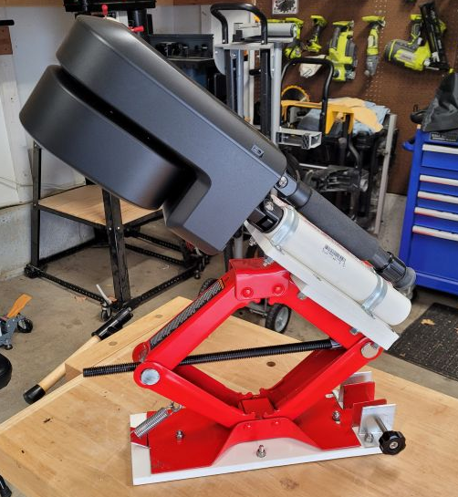
Homemade / photo tripods

Slide 7
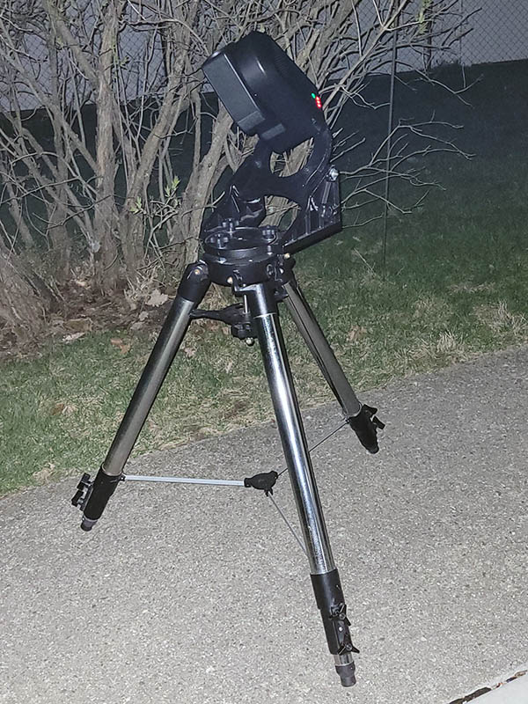
Other wedges

Slide 8
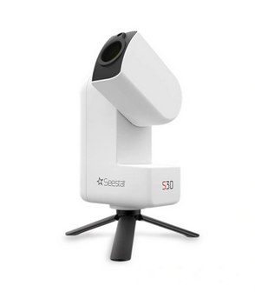
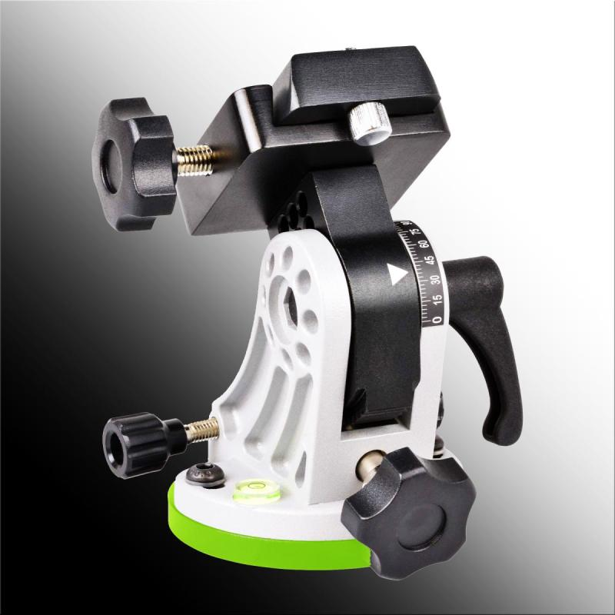
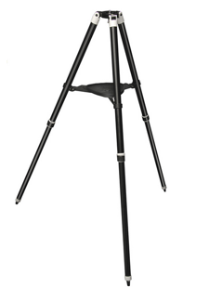
My rig

Slide 9
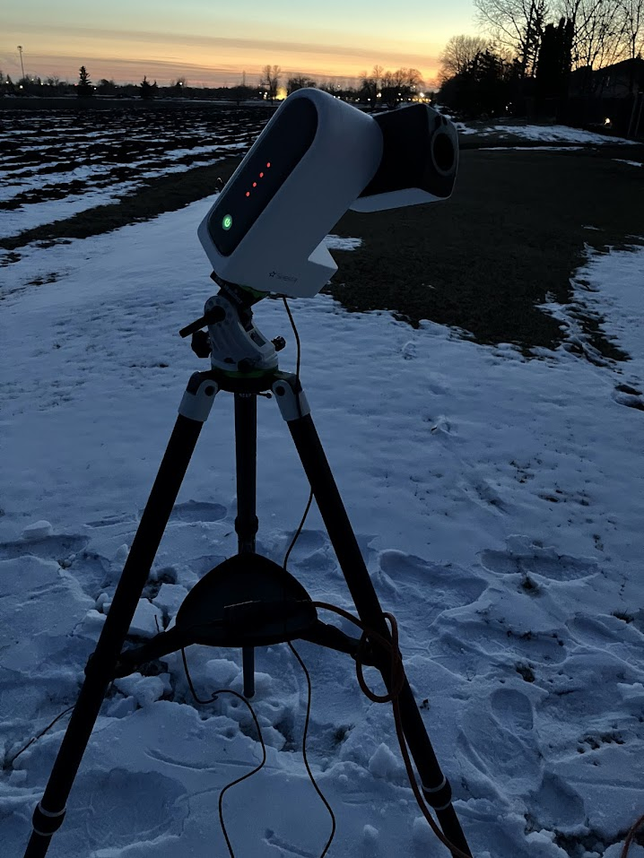
EQ mode setup and Alt/az adjustments
Note: Update the app on your phone/tablet so the next time you connect to the telescope it will update your firmware on the telescope!

Slide 10
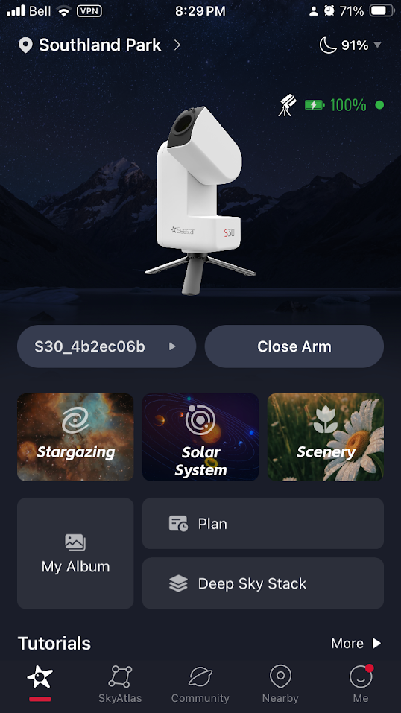
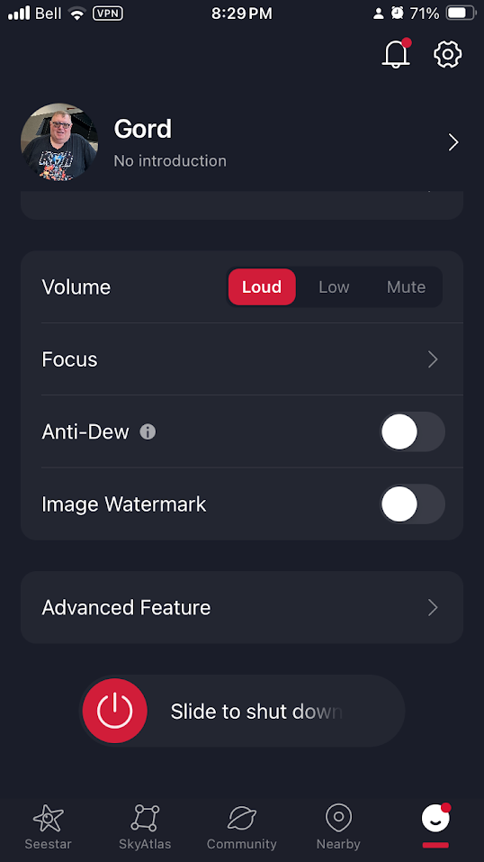
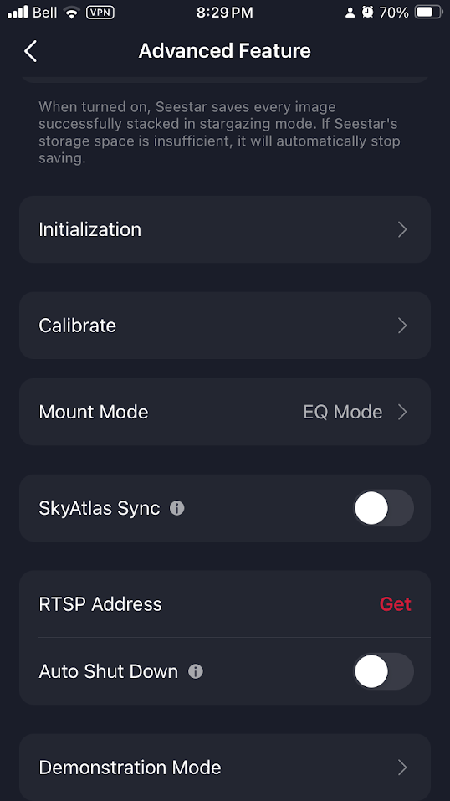
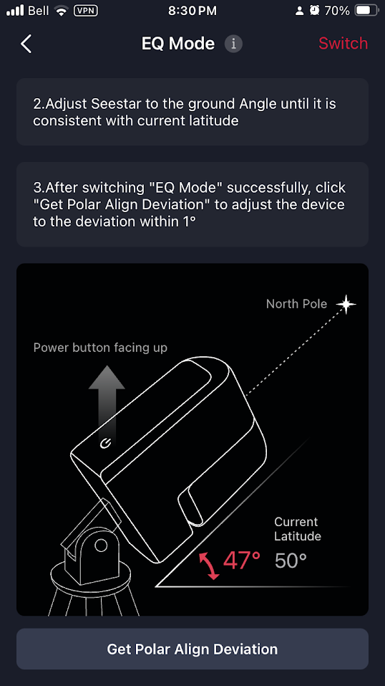

Slide 11
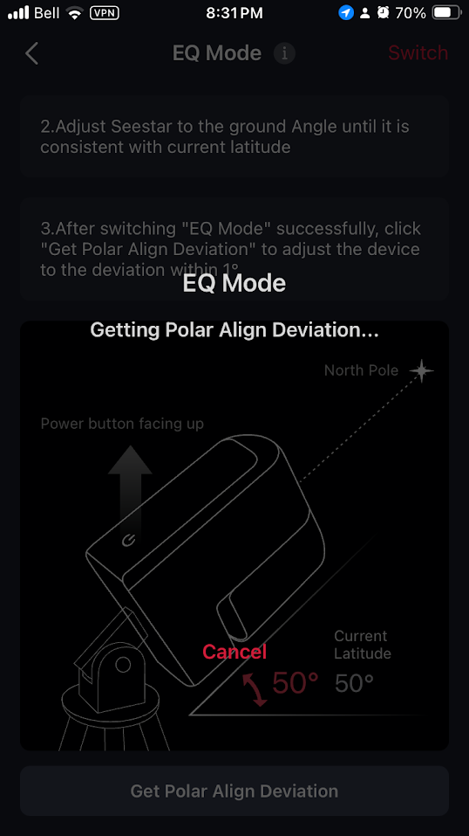
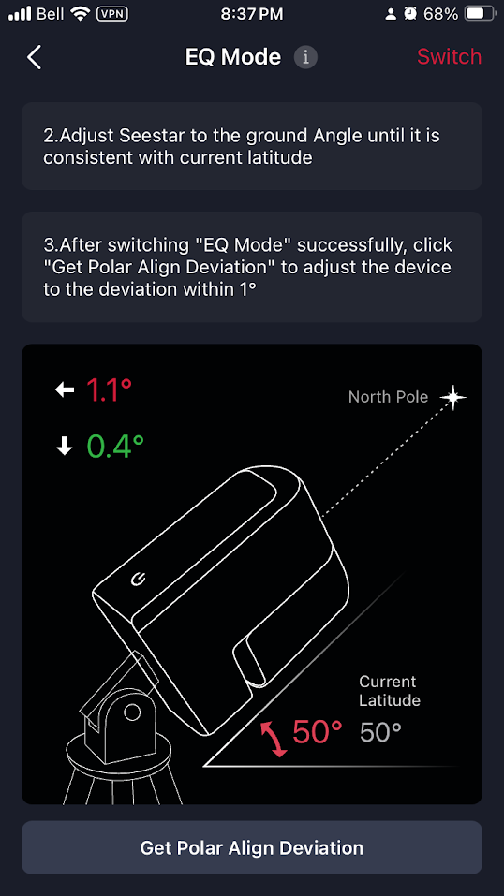
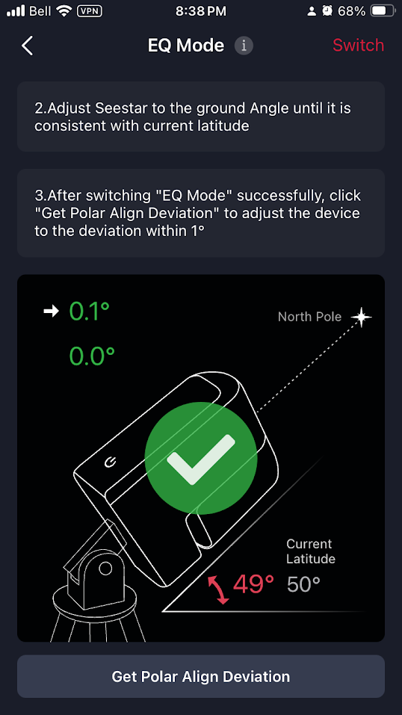

Slide 12
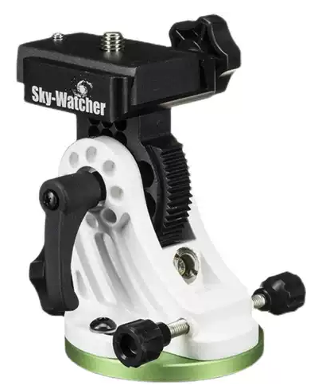
Altitude Adjustment
Azimuth Adjustment

Slide 13
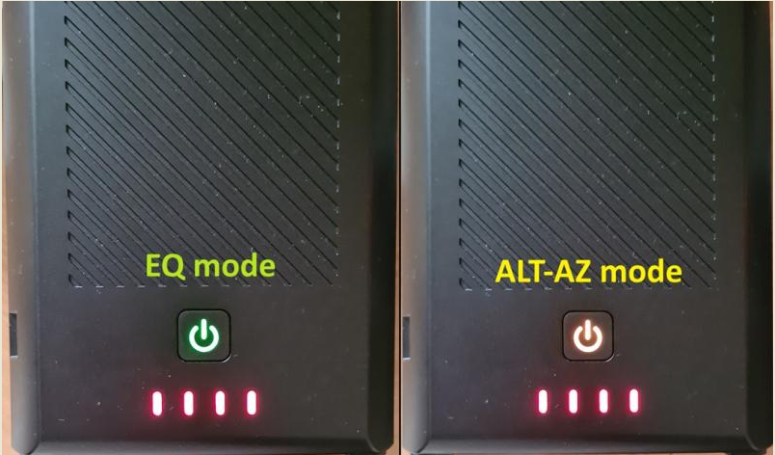
Indicator lights

Slide 14
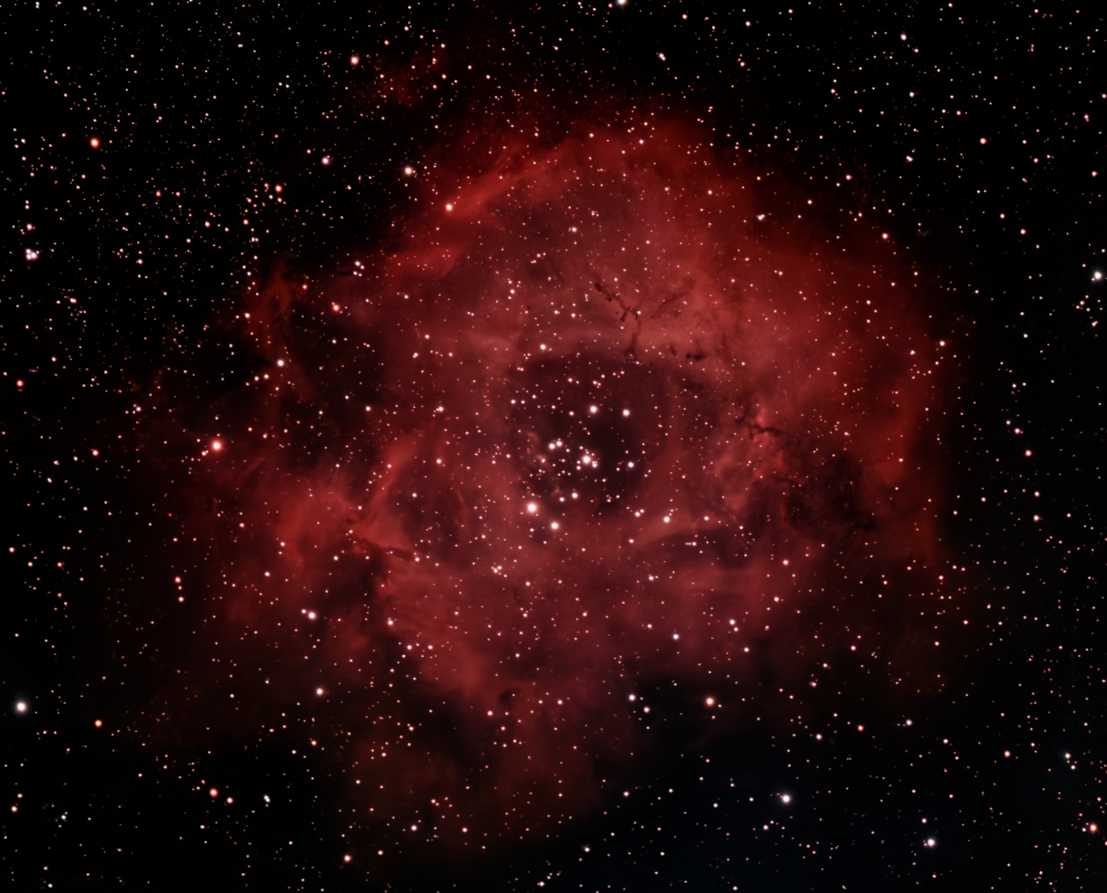
Rosette Nebula (Caldwell 49) Seestar S39 Mosaic EQ 103mins

Slide 15
Markarian’s Chain Member galaxies include M84 (NGC 4374), M86 (NGC 4406), NGC 4477, NGC 4473, NGC 4461, NGC 4458, NGC 4438 and NGC 4435.
Seestar S30 22min EQ

Slide 16
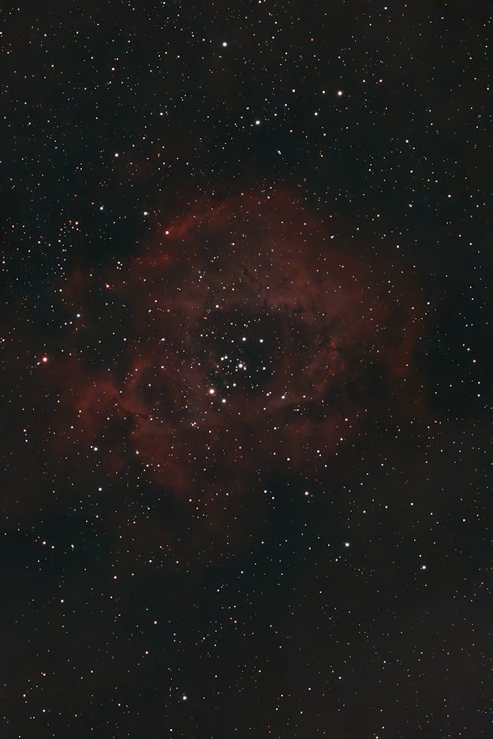
Questions?
My Web Sites
https://openastronomy.substack.com
https://www.openastronomy.ca
My email
gord.Tulloch@gmail.com
First EQ Light – Rosette 20m uncropped

